Slide 1
Data Storytelling & Statistical Validation
- Deep-Dive Analysis of Sales Performance
Prepared by: Chandrika Mellacheruvu

Slide 2
OBJECTIVE The objective of this project is to analyze sales data, identify key business insights, validate findings using statistical methods, and provide recommendations that support data-driven business decisions. .
Goals
‘Analyze overall sales performance.
Identify high-performing products and categories.
Understand customer purchasing behavior.
Study monthly sales trends.
Validate findings through hypothesis testing.
Recommend business improvements.

Slide 3
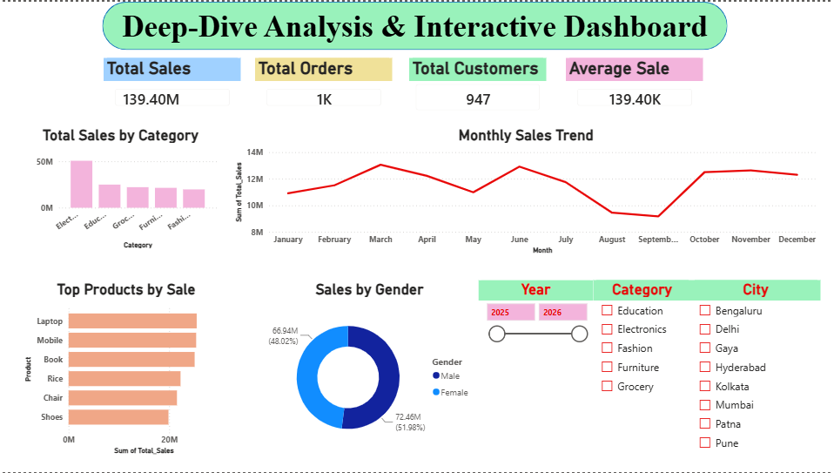
Dashboard Overview
This interactive dashboard provides a comprehensive overview of business performance. It combines key performance indicators, category-wise sales, product performance, customer demographics, and monthly sales trends into a single view. The dashboard enables management to monitor business performance and make informed decisions based on real-time insights.

Slide 4
Overall Business Performance
Business Story
The company achieved strong overall sales with a healthy customer base and consistent order volume. The average sale value indicates that customers make relatively high-value purchases, reflecting positive business performance.
Key Insights
Total Sales: ₹139.40 Million
Total Orders: 1,000
Total Customers: 947
Average Sale: ₹139.40K

Slide 5
Sales Performance Analysis
Key Insights
Electronics generated the highest revenue.
Laptops and Mobile phones are the best-selling products.
Other categories contribute to a diversified revenue stream.
Recommendation
Increase inventory and promotional campaigns for Electronics while using cross-selling strategies to improve sales of complementary products.

Slide 6
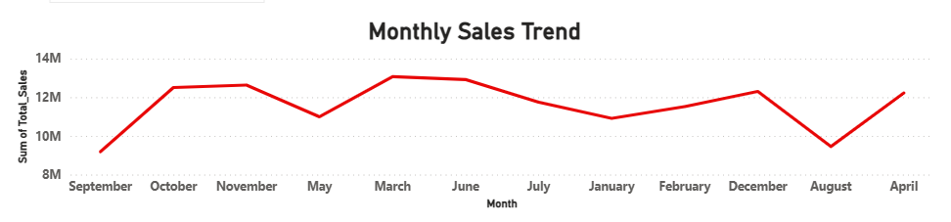
Monthly Sales Trend
Key Insights
Sales peaked during March, June, October, and November.
Sales declined during August and September.
The business shows seasonal purchasing patterns.
Recommendation
Launch promotional campaigns during low-performing months and prepare inventory ahead of peak sales periods.

Slide 7
Customer Analysis
Key Insights
Male customers contributed approximately 52% of total sales.
Female customers contributed approximately 48% of total sales.
Sales are almost equally distributed between both customer groups.
Recommendation
Maintain inclusive marketing strategies while exploring further customer segmentation based on age, city, and purchasing behavior.

Slide 8
Statistical Validation
Business Question
Is there a statistically significant difference in average sales between male and female customers?
Hypotheses
H₀: There is no significant difference in average sales between male and female customers.
H₁: There is a significant difference in average sales between male and female customers.
Statistical Test
Independent Samples t-test
Results
Male Average Sales: ₹141,807
Female Average Sales: ₹136,883
P-value: 0.49538926844824827
Interpretation
Since the p-value is greater than 0.05, we fail to reject the null hypothesis. The observed difference in average sales between male and female customers is not statistically significant.
Business Conclusion
The company should continue balanced marketing strategies rather than creating separate campaigns based solely on gender.

Slide 9
Recommendations & Conclusion
Recommendations
Continue investing in Electronics, the highest-performing category.
Ensure adequate inventory for top-selling products such as Laptops and Mobiles.
Implement promotional campaigns during August and September to improve seasonal sales.
Continue inclusive marketing strategies across all customer groups.
Use dashboards and statistical analysis to support future business decisions.
Conclusion
This project successfully transformed raw sales data into meaningful business insights through interactive dashboards and statistical validation. The analysis demonstrates how data-driven decision-making can help organizations improve sales performance, optimize marketing strategies, and achieve sustainable business growth.

